Slide 1

Let’s start with Allah Yaar
Bs in Computer Science

Slide 2
Safety and Security
Safety and security are fundamental in the digital world to ensure that data remains confidential, intact, and accessible only to authorized users. These concepts encompass understanding potential threats to data and the mechanisms for protecting data. Below is an in-depth explanation of each outline point.

Slide 3
Threats to Data
Threats to data are risks or activities that could compromise the integrity, confidentiality, or availability of information. These threats can come from various sources, such as human error, cybercriminals, or system vulnerabilities.

Slide 4
Threats to Data
Types of Threats
Physical Threats:
Explanation: These include physical damage to hardware or storage devices due to environmental factors (fire, flood, earthquakes) or intentional damage (theft or sabotage).
Example: A fire in a server room that destroys hard drives and backups.

Slide 5
Threats to Data
Cyber Threats:
Explanation: Threats that occur in the digital realm, often involving unauthorized access, malicious software, or hacking.
Types:
Viruses and Malware: Programs that damage or disrupt systems. Example: A ransomware attack encrypting files and demanding payment for decryption.
Phishing: Fraudulent attempts to steal sensitive information by pretending to be a trustworthy entity. Example: Fake emails asking users to click a link and enter their bank details.

Slide 6
Threats to Data
Human Threats:
Explanation: Mistakes or intentional malicious activities by individuals, including insiders or attackers.
Example: An employee accidentally deleting critical files or sharing passwords.

Slide 7
Threats to Data
System Vulnerabilities:
Explanation: Weaknesses in software, hardware, or network configurations that attackers can exploit.
Example: Outdated operating systems prone to security breaches.

Slide 8
Protection of Data
Protecting data involves implementing measures to safeguard information from loss, theft, or unauthorized access. These measures can be categorized into physical, administrative, and technical safeguards.

Slide 9
Protection of Data
Methods of Data Protection
Data Encryption:
Explanation: Encoding data to make it unreadable to unauthorized users.
Example: End-to-end encryption in messaging apps like WhatsApp ensures only the sender and recipient can read the messages.

Slide 10
Protection of Data
Access Controls:
Explanation: Restricting access to data based on user roles and permissions.
Example: Only administrators can access confidential records, while employees have limited permissions.
Backup and Recovery:
Explanation: Regularly creating copies of data and storing them securely for retrieval during data loss.
Example: Cloud backups of critical files stored on platforms like Google Drive.

Slide 11
Protection of Data
Anti-Malware Software:
Explanation: Programs designed to detect and remove malicious software.
Example: Installing antivirus software like Norton or McAfee to protect against viruses.
Firewall and Network Security:
Explanation: Firewalls block unauthorized access to a network. Network security ensures safe data transmission.
Example: Using a firewall to prevent hackers from accessing a company's internal network.

Slide 12
Protection of Data
Physical Security:
Explanation: Protecting physical devices from theft or damage.
Example: Locked server rooms and biometric access control systems.

Slide 13
Protection of Data
Authentication Mechanisms:
Explanation: Ensuring only authorized users can access systems using passwords, biometrics, or multi-factor authentication (MFA).
Example: A banking app requiring a password and a one-time password (OTP) sent to your phone.

Slide 14
Protection of Data
Best Practices for Data Protection
Regularly update software to fix vulnerabilities.
Example: Applying security patches in operating systems.
Educate users about phishing and other threats.
Example: Conducting awareness sessions for employees about email scams.

Slide 15
Protection of Data
Implement strict password policies.
Example: Mandating complex passwords that expire every three months.
Use secure data disposal methods.
Example: Shredding documents or using data wiping software for old hard drives.

Slide 16
Protection of Data
Real-Life Scenario for Threats and Protection
A multinational company faced a ransomware attack where attackers encrypted all financial records and demanded payment.
Threat: Lack of updated anti-malware software and weak user education on phishing emails.
Protection: The company implemented data encryption, regular backups, and employee cybersecurity training post-incident.

Slide 17
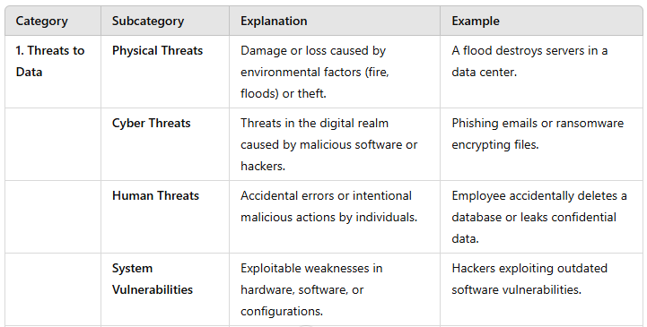
Summary Table

Slide 18
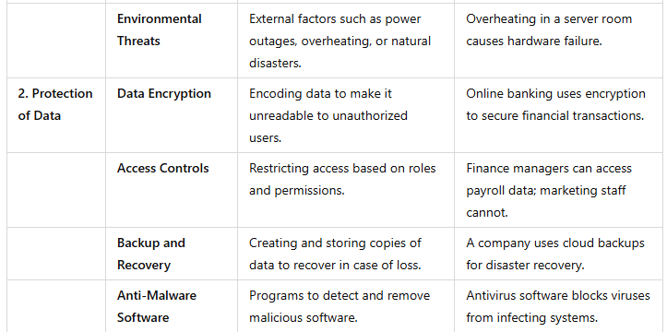
Summary Table

Slide 19
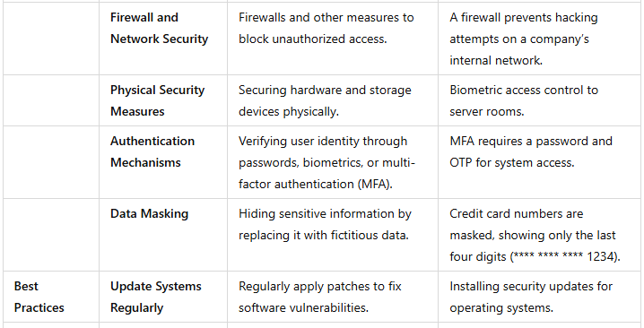
Summary Table

Slide 20
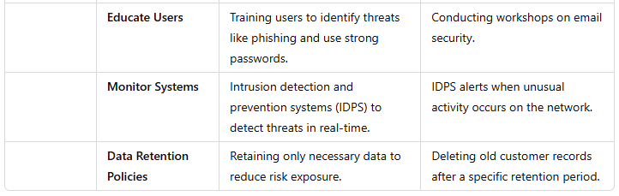
Summary Table

